Slide 1


WindowBuilder
Guillermo Esquivel González
Nicolás Hernández González
Programación de Aplicaciones Interactivas
Notes:
4/27/17
1
1

Slide 2
Index
What will we talk about?
What is WindowBuilder
How to install WindowBuilder
Short introduction for a quick start
Distribution of the window
Wizards
Layout Managers
Exmples
Notes:
4/27/17
2
2

Slide 3
What is WindowBuilder?
Java GUI designer
Makes easy creating complicated windows
Visual Designer and Java Code
Drag-and-Drop
Add event handlers
Notes:
4/27/17
3
3

Slide 4
Installation
In Eclipse, click Help > Install New Software…
Get the proper link from http://www.eclipse.org/windowbuilder/download.php
In the Available Software dialog, enter the product's update site location and select all the items to install. Click Next to continue.
Click Next to confirm installation.
Accept the license agreement. Click Finish.
Restart Eclipse.
Notes:
4/27/17
4
4

Slide 5
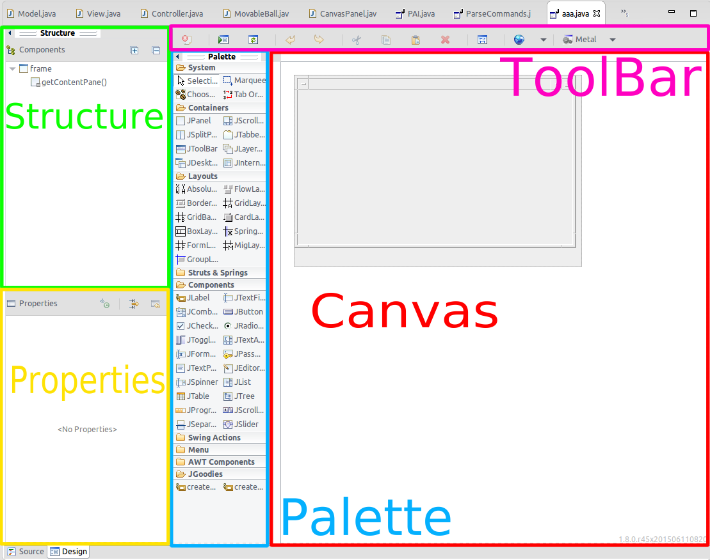
Distribution of the window
Design View
Source View
Structure View
Component Tree
Property Pane
Palette
Toolbar
Context Menu
Notes:
4/27/17
5
5

Slide 6
Short introduction for a quick start
Create a new project using the appropriate project wizard
Notes:
4/27/17
6
6

Slide 7
Short introduction for a quick start
Use class wizard to create your GUI window
Notes:
4/27/17
7
7

Slide 8
Short introduction for a quick start
A class with some existing code is created.
Notes:
4/27/17
8
8

Slide 9
Short introduction for a quick start
To use the windowBuilder click on the "Design tab" at the bottom of the editor
Notes:
4/27/17
9
9

Slide 10
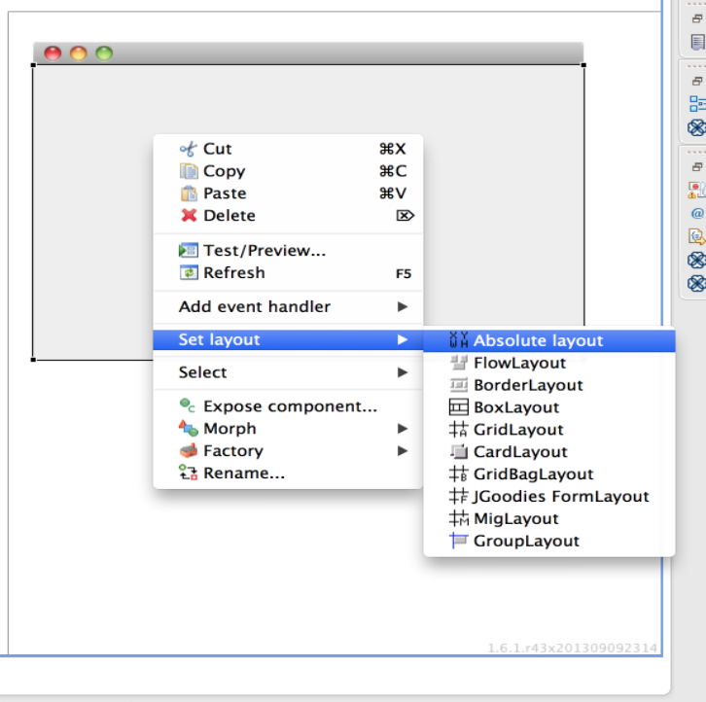
Short introduction for a quick start
To set layout, right click on the window frame and select " set layout " and select the appropriate layout
Notes:
4/27/17
10
10

Slide 11
Short introduction for a quick start
Add various components from the Palette and edit their properties using the Property Pane.
Notes:
4/27/17
11
11

Slide 12
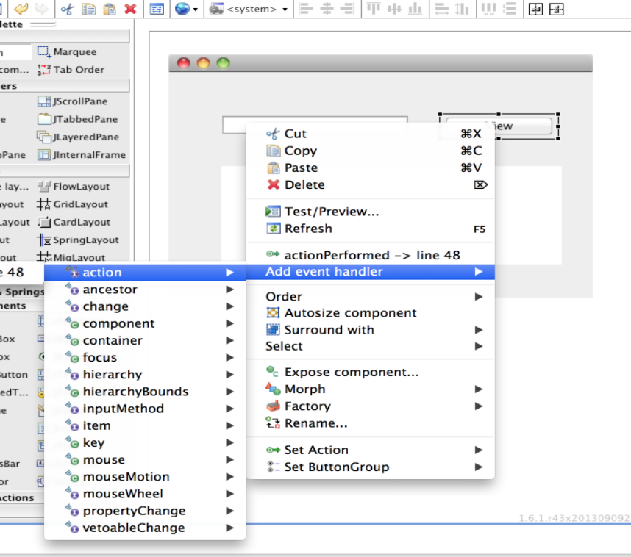
Short introduction for a quick start
Add event handler to various widgets to provide behavior
Notes:
4/27/17
12
12

Slide 13
Features
Bi-directional Code Generation
Directly generates Java code
The tool can read and write almost any format
Reverse-engineer most hand-written Java GUI code.
Notes:
4/27/17
13
13

Slide 14
Features
Internationalization (i18n)
Directly generates Java code
The tool can read and write almost any format
Reverse-engineer most hand-written Java GUI code.
Notes:
4/27/17
14
14

Slide 15
Wizards
Swing
JFrame
JPanel
JDialog
JApplet
JInternalFrame
Application Window
Automatic Data Binding
Notes:
4/27/17
15
15

Slide 16
Bibliography
Help eclipse
Eclipse windowBuilder
Eclipse proposals windowBuilder
Notes:
4/27/17
16
16

Slide 17

END
THANKS!
You can find as alu0100881677 & alu0100898293
Slides and code at Github repo
Any Question?
Notes:
4/27/17
17
17

